Slide 1

SQL Management Studio
Rich Metadata Extraction
Shrikesh Pattni

Slide 2
T-SQL Rich Metadata Extractions
SQL – Data Warehousing Architecture
Metadata
Raw Data
Validation/
Unharmonized
Data Rules
Semi-Harmonisation
Metadata/ETL
Harmonisation
Source/ETL
Model Building
CI/CD Model Deployment
BEAM Methodology
Enterprise Data Fabric
Data Quality
Data Value Chain
Work with Data Providers on a roadmap
Conducting a preliminary data source analysis (data type and structure, volume, sensitivity, etc.).
Choosing the optimal architectural design approach to building a data warehouse.
Choosing the optimal deployment option (on-premises/in-cloud/hybrid).
Selecting the data warehouse technologies (DWH database, ETL/ELT tools
Number of data sources and data volume to be loaded
Identification if any data is absent/of enough quality to support the business requirements.
Data sensitivity access approach.
Data security rules, data encryption policies, policies for data access monitoring
Designing data cleansing policies.
Mapping data objects into the data warehouse.
Designing ET processes for data integration and data flow control.
Designing data models for the data warehouse and data marts.
Identifying data objects as entities or attributes; identifying relationships between entities.
CI/CD is a means to managing change in a controlled way
Effective change management enables it to be more adaptive and therefore more useful as a business tool.
Business Event Analysis & Modelling, to understand the question we to formulate for the insights to answer.
Metadata Process Alignment
Who Created…
Where is the data…
What does the data…
How does the data…
When does the data…
Why did this happen..

Slide 3
How we should think of Master Metadata Management
Data Warehouse
Volume: SQL Tables, Dev/Test/Production
Volume: 3,000 + data assets in enterprise heavy data projects
Velocity: Data is updated daily/weekly with increments
Variety: Increase in complexity of relationships/data types
Veracity: Daily backups/Version control enables quality
Value: Timestamp data attributes,
Metadata/Governance
Value: Removing confusion by understanding data definitions
Value: Better levels of completeness/accuracy/row count of data
Value: Removing assumptions and guess work on data structure
Value: Better levels of performance optimisations on data assets
Value: Increase confidence to technical/non technical stakeholders
Value : *All above resulting In better communication channels*
Data Warehouse
Data Taxonomy
Variety: Classification of data assets into valuable entities
Value: Data Dictionary enables better levels of insights
Veracity: Increase data trust to increase value and engagement
Veracity: Remove biased and falsification (integer value column)
Metadata/Governance
Value Creation
Value: Richer, tangible value around Data Analytics
Value: Team engagement, active as opposed to reactive culture
Value: Internal/External operational value add changes
Value: Performance Optimisations on data assets
Taxonomy
Value Creation

Slide 4
T-SQL Rich Metadata Extractions – Implementation for SQL Database
SQL Sever 2019 Examples of Metadata Extractions
Valuable
Valuable
Valuable
Version Infor
Core Counts
Server Properties
Configuration Values
Global Trace Flags
Process Memory
Server Info
Database Backup
Agent Jobs
Host Info
SQL NUMA Info
System Memory
Node Properties
AG Cluster
Memory Infor
Error Log Entries
Temp DB Data Files
Filenames and Paths
Data Volume Info
Latency Infor
Latency by File
IO Warning
Resource Pools
Database Properties
Missing Indexes on Properties
VLF Count
CPU Usage by Database
Usage by Database
Total Buffer by Usage Database
Version Store Space Usage
Top Waits
Connection Count by IP Address
Avg Task Count
Detect Blocking
Page Contention
CPU Utilization
Top Worker Time Queries
NUMA Nodes
Memory Grants Pending
Memory Clerk Usage
Adhoc Queries
Top Logical Reads
Top Avg Elapsed Time Queries
Stats by Database
File Size and Space
Log Space Usage
VLF Status
Database Scoped Configuration
Stats by File
Query Execution Count
SP Execution Count
SP Avg Elapsed Time
SP Worker Time
SP Logical Reads
SP Physical Reads
SP Logical Writes
SP Missing Index
TOP IO Statements
Missing Indexes
Bad NC Indexes
Buffer Usage
Table Sizes
Table Properties
Statistics Updates
Volatile Indexes
Index Fragmentation
Index Usage
Overall Index
Lock Waits
Querystore Options
Table Space Usage
View Definitions
Schemas Definitions
Datatype Define
Table Summary Counts
Version Infor
Table with similar structures
Blocking Queries
Buffer Cache
Database File % used
Relationships between tables
List of all columns
Total Row Count
Create 2M Tables
Count Reads and Writes
Database Leaks
Foreign Key Chains
Find Weak Passwords
Estimate Query Runtime
Columns to make skinnier
Get Table and
Storage Size
How old are SQL Backups
Cost to build or save an Index
What is the Table Hierarchy
Non-Clustered/Clustered
Log used %
What Columns are NULL
View Counts Per Database

Slide 5
00
Find all Schemas/Tables
Shrikesh Pattni

Slide 6
01
Get a Data Dictionary view of a selected database
Shrikesh Pattni

Slide 7
02
Get all databases meta data Dynamic SQL
Shrikesh Pattni

Slide 8
03
Get Identity Column Information
Shrikesh Pattni

Slide 9
04
Understand and check “View Definitions”
Shrikesh Pattni

Slide 10
05
Find table with similar attributes/entities
Shrikesh Pattni

Slide 11
06
Find Blocking Queries
Shrikesh Pattni

Slide 12
07
How much space has been used by tables
Shrikesh Pattni

Slide 13
08
What is the SQL Buffer Cache
Shrikesh Pattni

Slide 14
09
What is a databases CPU Utilization
Shrikesh Pattni

Slide 15
10
Find the space left in the Database Files
Shrikesh Pattni

Slide 16
11
What are the current relationships between the tables in the database
Shrikesh Pattni

Slide 17
12
Get a list of all columns/attributes within a database
Shrikesh Pattni

Slide 18
13
Total Row Count on all tables in a database
Shrikesh Pattni

Slide 19
14
Automatically create 2.1M tables
Shrikesh Pattni

Slide 20
15
Count all databases reads and write
Shrikesh Pattni

Slide 21
16
What are total counts of all database summary stats
Shrikesh Pattni

Slide 22
17
Do we have database leak connections?
Shrikesh Pattni

Slide 23
18
Find Foreign Key Chains
Shrikesh Pattni

Slide 24
19
Where are the legacy based tables?
Shrikesh Pattni

Slide 25
20
Do we have weak database passwords
Shrikesh Pattni

Slide 26
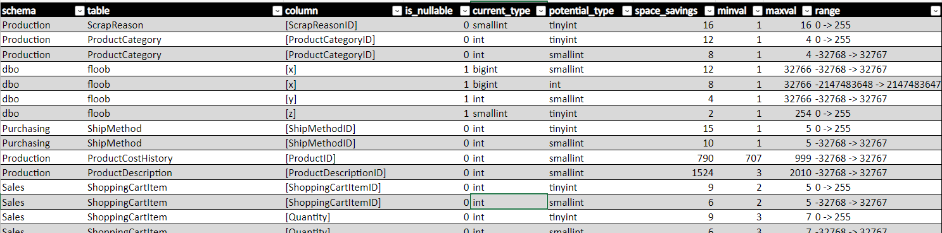
21
Find out what columns we can better optimised by correctly using better data types
Shrikesh Pattni

Slide 27
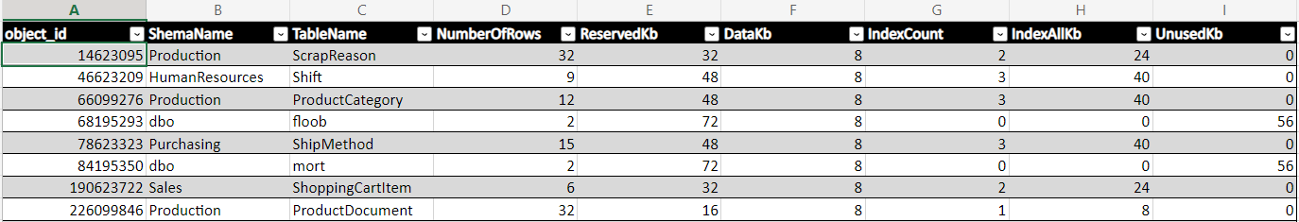
22
Understand the index storage size
Shrikesh Pattni

Slide 28
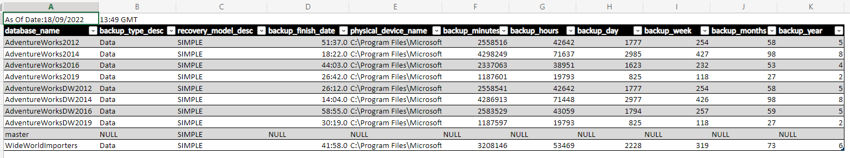
23
How old are my database backups.
Minutes/Hours/Days/Weeks/Months/Year
Shrikesh Pattni

Slide 29
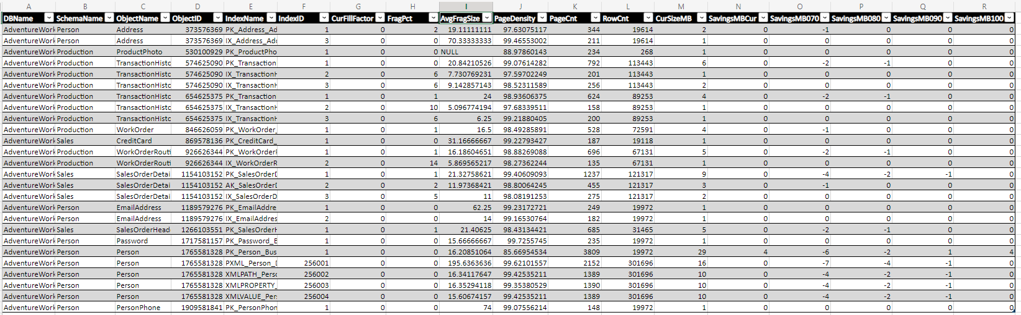
24
How much does it cost to build and index
Shrikesh Pattni

Slide 30
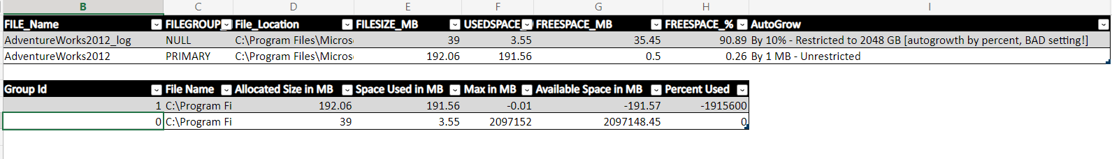
How much space do we have in the database log file
25
Shrikesh Pattni

Slide 31
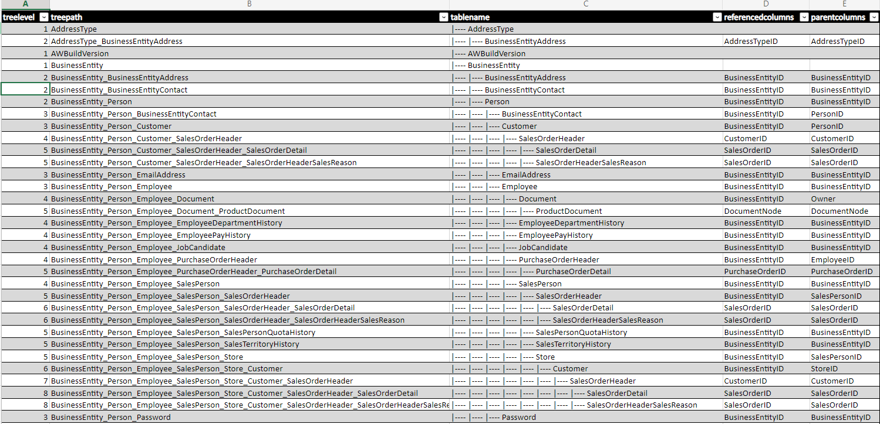
Create and extract a table hierarchy from the sys.foreign_key and sys_tables
26
Shrikesh Pattni

Slide 32
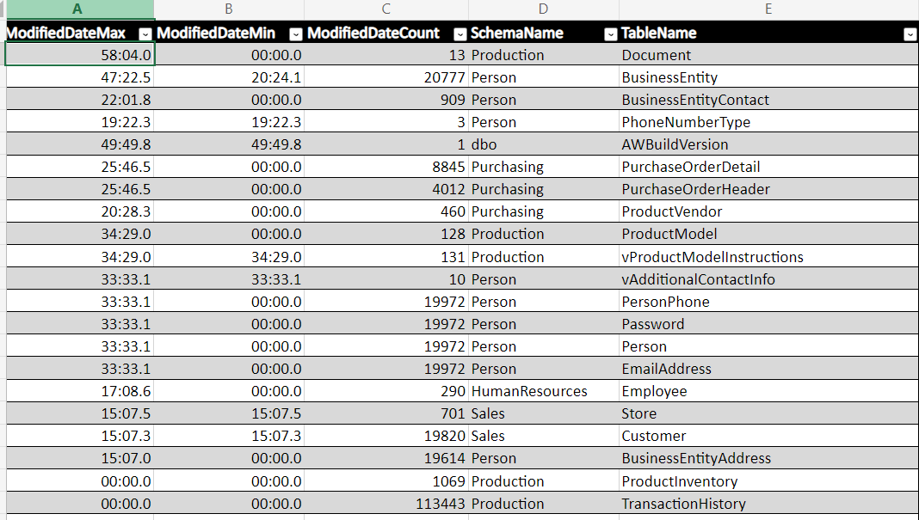
Create a data governance process to understand when columns in tables were last modified
27
Shrikesh Pattni

Slide 33
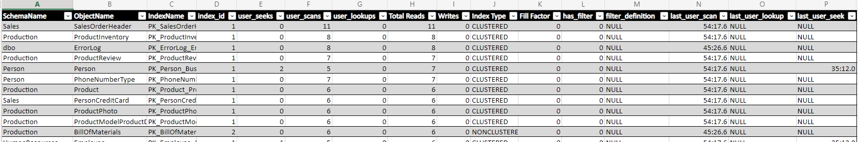
Create a data governance process to understand all indexes a database has on schemas and tables
28
Shrikesh Pattni

Slide 34
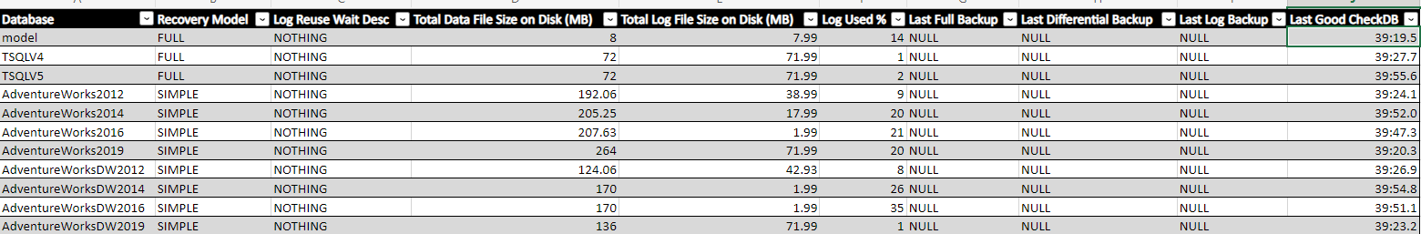
Understand “Total Data” and “Total Log” file size on disk (MB) while understanding Log Used %
29
Shrikesh Pattni

Slide 35
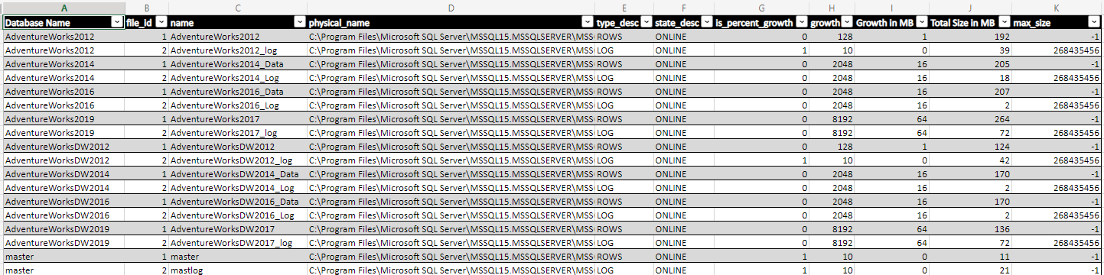
Understand the system database files information
30
Shrikesh Pattni

Slide 36
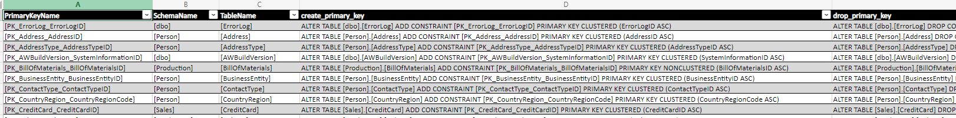
Extract of primary keys from a database
31
Shrikesh Pattni

Slide 37
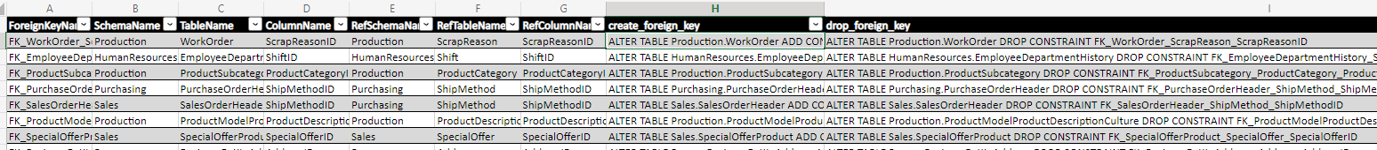
Extract of foreign keys from a database
32
Shrikesh Pattni

Slide 38
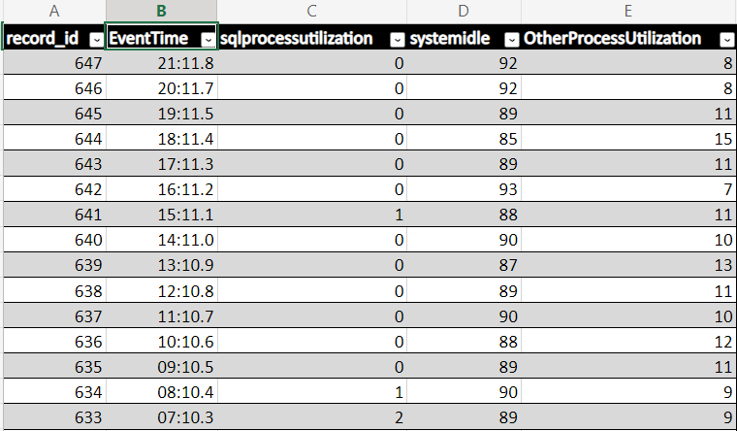
Understand CPU Utilisation
33
Shrikesh Pattni

Slide 39
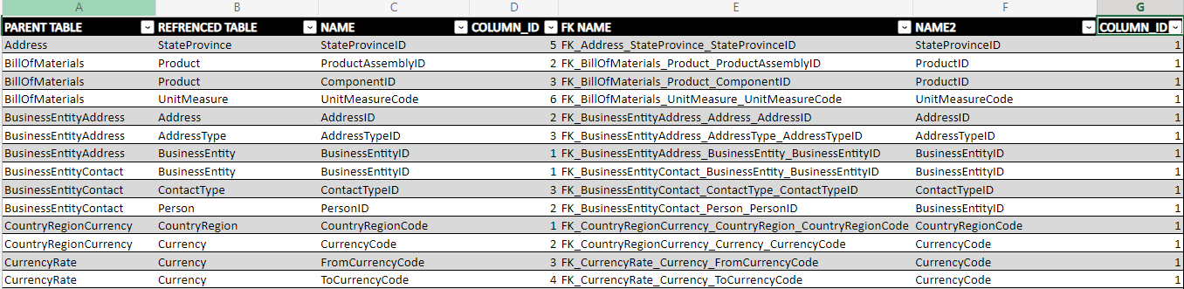
Find relationships between tables from parent table to referenced tables to its FK Name
34
Shrikesh Pattni

Slide 40
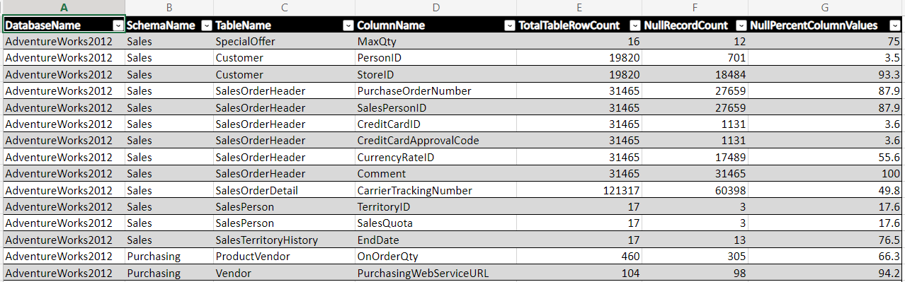
Find all the NULL value record counts and NULL value % in a database in order to optimise the tables
35
Shrikesh Pattni

Slide 41
Find all empty values record count and the empty value % count per column in a database
36
Shrikesh Pattni

Slide 42
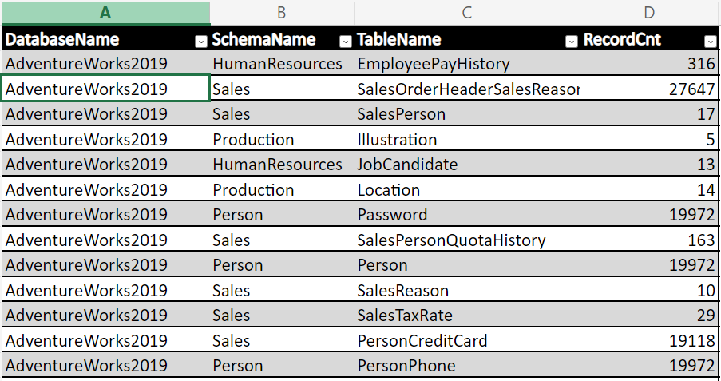
Find all record counts of the schema/tables in a database
37
Shrikesh Pattni

Slide 43
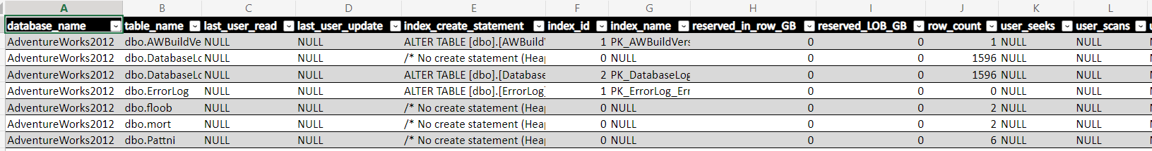
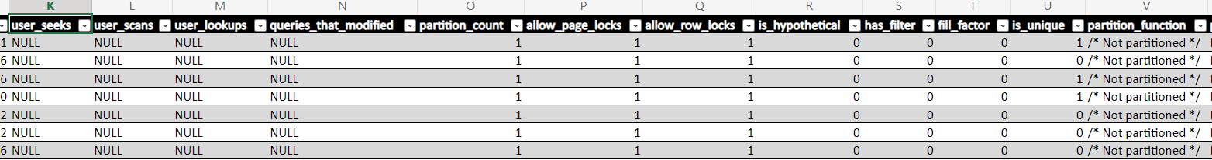
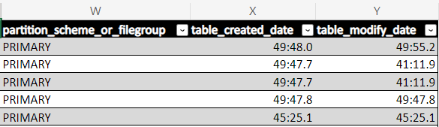
Get detailed Index information
38
Shrikesh Pattni

Slide 44
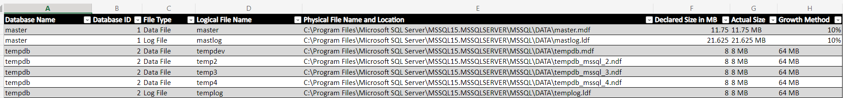
Get information on database file size growth
39
Shrikesh Pattni

Slide 45
Get information on database file size growth
40
Shrikesh Pattni

Slide 46
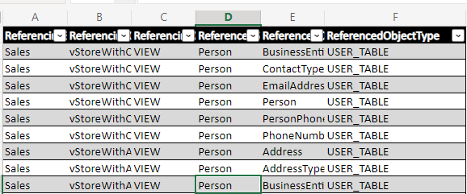
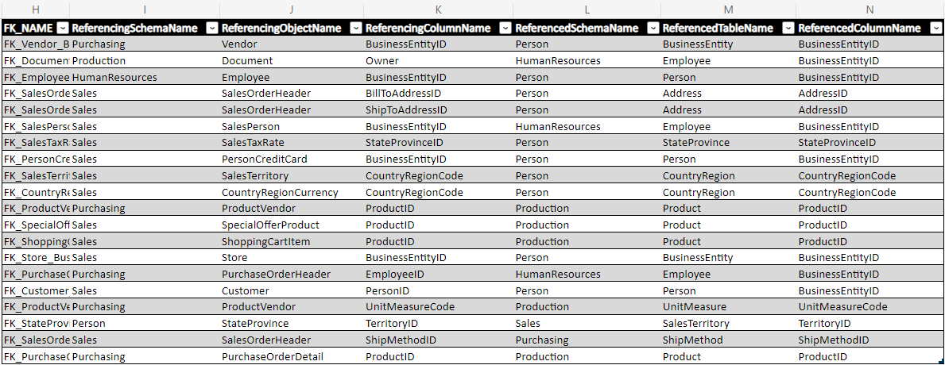
Understand and validate database dependency objects
41
Shrikesh Pattni

Slide 47
Understand and validate database dependency objects
42
Shrikesh Pattni

Slide 48
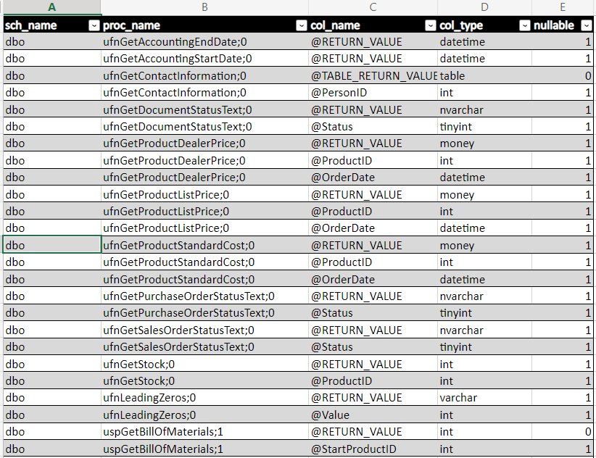
Understand and extract all Store Procedures
43
Shrikesh Pattni

